Slide 1
Course Title - Web System Engineering
Topic Title – Basics of PHP
Presenter’s Name - M ArunKumar
Presenter’s ID - IARE11151
Department Name - CSE ( Artificial Intelligence, and Machine Learning )
Lecture Number - #
Presentation Date - ##/04/2025

Slide 2
Basics of PHP
https://windows.php.net/download/
XAMPP is an easy to install Apache distribution containing MariaDB, PHP, and Perl. Just download and start the installer. It's that easy. Installers created using InstallBuilder.
https://www.apachefriends.org/download.html
C:\xampp\htdocs\mywebapps
http://localhost/mywebapps/demo1.php

Slide 3
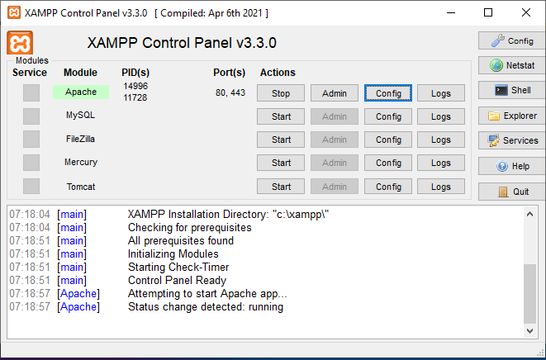
Basics of PHP

Slide 4
Basic Of PHP
Arrays in PHP
An array in PHP is a variable that can store multiple values. Arrays can be indexed (using integers) or associative (using named keys).
Indexed Arrays: Arrays where the index is an integer.
$fruits = array("Apple", "Banana", "Cherry");
echo $fruits[1]; // Output: Banana
Associative Arrays: Arrays where the index is a string.
$person = array("name" => "John", "age" => 25);
echo $person["name"]; // Output: John
Multidimensional Arrays: Arrays that contain other arrays.
$matrix = array(
array(1, 2, 3),
array(4, 5, 6)
);
echo $matrix[1][2]; // Output: 6

Slide 5
Basic Of PHP
Strings in PHP
A string in PHP is a sequence of characters enclosed in either single quotes (') or double quotes ("). The difference is that double quotes allow for variable parsing and escape sequences like \n for newline.
$singleQuoted = 'Hello World!';
$doubleQuoted = "Hello, $name!"; // Allows variable substitution
echo $singleQuoted; // Output: Hello World!
You can also use string functions to manipulate strings:
$length = strlen("Hello"); // Length of string
$upper = strtoupper("hello"); // Converts to uppercase
$replace = str_replace("World", "PHP", "Hello World"); // Replaces text

Slide 6
Basic Of PHP
Operations in PHP
Arithmetic Operations
Comparison Operations:
Logical Operations:

Slide 7
Basic Of PHP
Control Structures in PHP
Control structures allow you to control the flow of the program. Here are the main ones:
If-Else: Conditional statement to execute code based on a condition.
if ($age >= 18) {
echo "You are an adult.";
} else {
echo "You are a minor.";
}

Slide 8
Basic Of PHP
Switch: Used for multiple conditions based on a variable.
switch ($day) {
case "Monday":
echo "Start of the week.";
break;
case "Friday":
echo "End of the week.";
break;
default:
echo "Midweek day.";
}

Slide 9
Basic Of PHP
Loops: Repeats a block of code.
For Loop: Useful when you know how many times to loop.
for ($i = 0; $i < 5; $i++) {
echo $i;
}
While Loop: Runs as long as the condition is true.
$i = 0;
while ($i < 5) {
echo $i;
$i++;
}

Slide 10
Basic Of PHP
Foreach Loop: Used for iterating over arrays.
$fruits = array("Apple", "Banana", "Cherry");
foreach ($fruits as $fruit) {
echo $fruit;
}

Slide 11
Basic Of PHP
Functions in PHP
A function is a block of code that performs a specific task and can be called multiple times.
Defining a function:
function greet($name) {
return "Hello, $name!";
}
echo greet("John"); // Output: Hello, John!

Slide 12
Basic Of PHP
Returning values: Functions can return a value that can be used later in the program.
function add($a, $b) {
return $a + $b;
}
$result = add(5, 3); // Result is 8

Slide 13
Basic Of PHP

Slide 14
Thank You

